Slide 1
How easily to make a POP song?
Speaker: Johnny

Slide 2
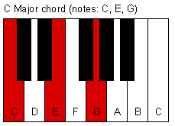
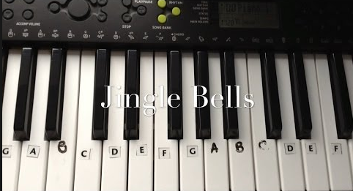
Easy POP Chorus Progression
Basis of chorus
Chorus on piano
Usually F –> G –> Em -> Am in whole song !

Slide 3
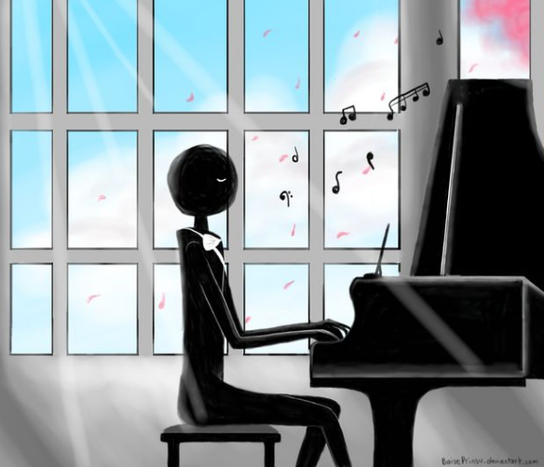
Melody For free !
Based on the chorus progress.
Listening and singing.

Slide 4
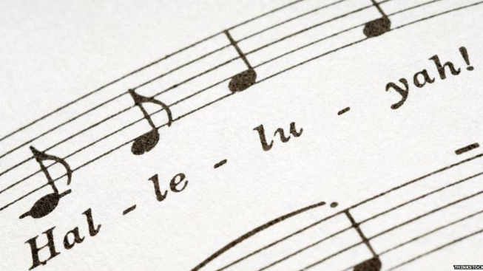
What’s In Your Mood?
Fill the lyrics in the melody!
POP music seldom talks about something meaningful.
Now watch me whip (Kill it!)
Now watch me nae nae (Okay!)
Now watch me whip whip
Watch me nae nae (Want me do it?)

Slide 5

Put Your Instrutment Down!
Using a music arrangement software.
Based on how familiar with those instrutment.

Slide 6
Questioning Time!

Slide 7
Thanks for listenening!

